Slide 1

Obstacle Avoiding Car
Day 5

Slide 2
Today
Basic programming elements
Conditions
Functions

Slide 3
Conditions
Let something happen if some requirements are fulfilled.
For example,

Slide 4


If this is Aftari time?
Have some food …

Slide 5
Similarly, in programming
if ( it is raining )
{
// look up, is there water falling on me?
if ( I have an umbrella )
{
OpenUmbrella();
//Opening Umbrella operation
}
}

Slide 6
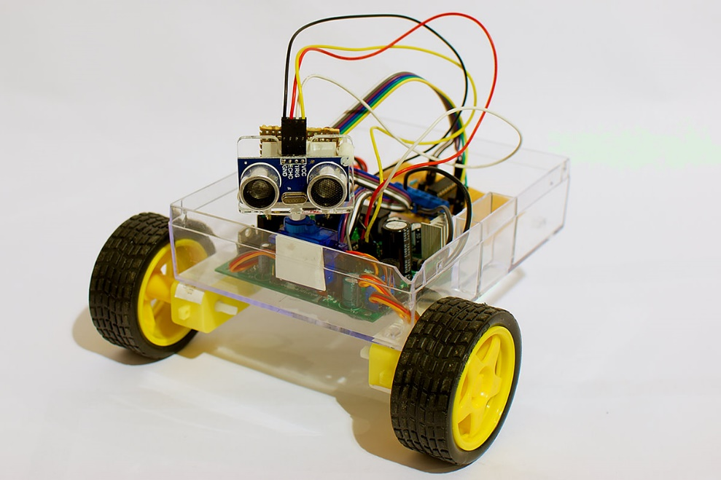
Today’s Task
We will make an obstacle avoiding car, and implement conditions in it.

Slide 7
What it will do?
Check if there is any hurdle
Stop if any hurdle appears
Move forward if there is no hurdle
Repeat the process

Slide 8
Let’s have a look at code!
void loop()
{
CheckDistance();
if(distance>15)
{
MoveForward();
}
}

Slide 9
Now looking inside …
Let us see what’s happening inside the functions!
void loop()
{
CheckDistance();
if(distance>15)
{
MoveForward();
}
}

Slide 10
Check Distance
void CheckDistance()
{
digitalWrite(trig, LOW);
delayMicroseconds(2);
digitalWrite(trig, HIGH);
delayMicroseconds(10);
digitalWrite(trig, LOW);
duration = pulseIn(echo, HIGH);
inches = duration/74/2;//converts time duration to inches
cm = duration / 29 / 2;//converts time duration to cm
distance = cm;
}

Slide 11
Move Forward
void MoveForward()
{
digitalWrite(in1, HIGH);
digitalWrite(in2, LOW);
analogWrite(enA, 150);
digitalWrite(in3, HIGH);
digitalWrite(in4, LOW);
analogWrite(enB, 150);
delay(1000);
}

Slide 12
Next Time
Next time we will add functions to move the car in all directions i.e.
Forward
Backward
Right
Left

